Slide 1
SMART CITY SENTINELS
Unplugged 2.0
Presented By BaudRate9600

Slide 2


BaudRate9600
8 MARCH 2025
Project Overview
Vision & Mission
Our Approach
Schematic
PCB
Tech Stack
Future Prospects
Conclusion
CONTENT

Slide 3

BaudRate9600
8 MARCH 2025
Smart City Sentinel is an AI-powered system designed to improve urban traffic flow and emergency response. Using computer vision, IoT, and cloud computing, it detects vehicles in real-time and dynamically adjusts traffic signals. The system prioritizes ambulances, fire trucks, and police vehicles, ensuring they reach their destinations faster. It also integrates license plate recognition to track violations and enhance road safety. With automated data analysis, cities can make informed decisions to reduce congestion and optimize traffic management. By leveraging smart technology, we aim to create safer, more efficient roads. Smart City Sentinel is a step toward the future of intelligent urban mobility
PROJECT OVERVIEW

Slide 4
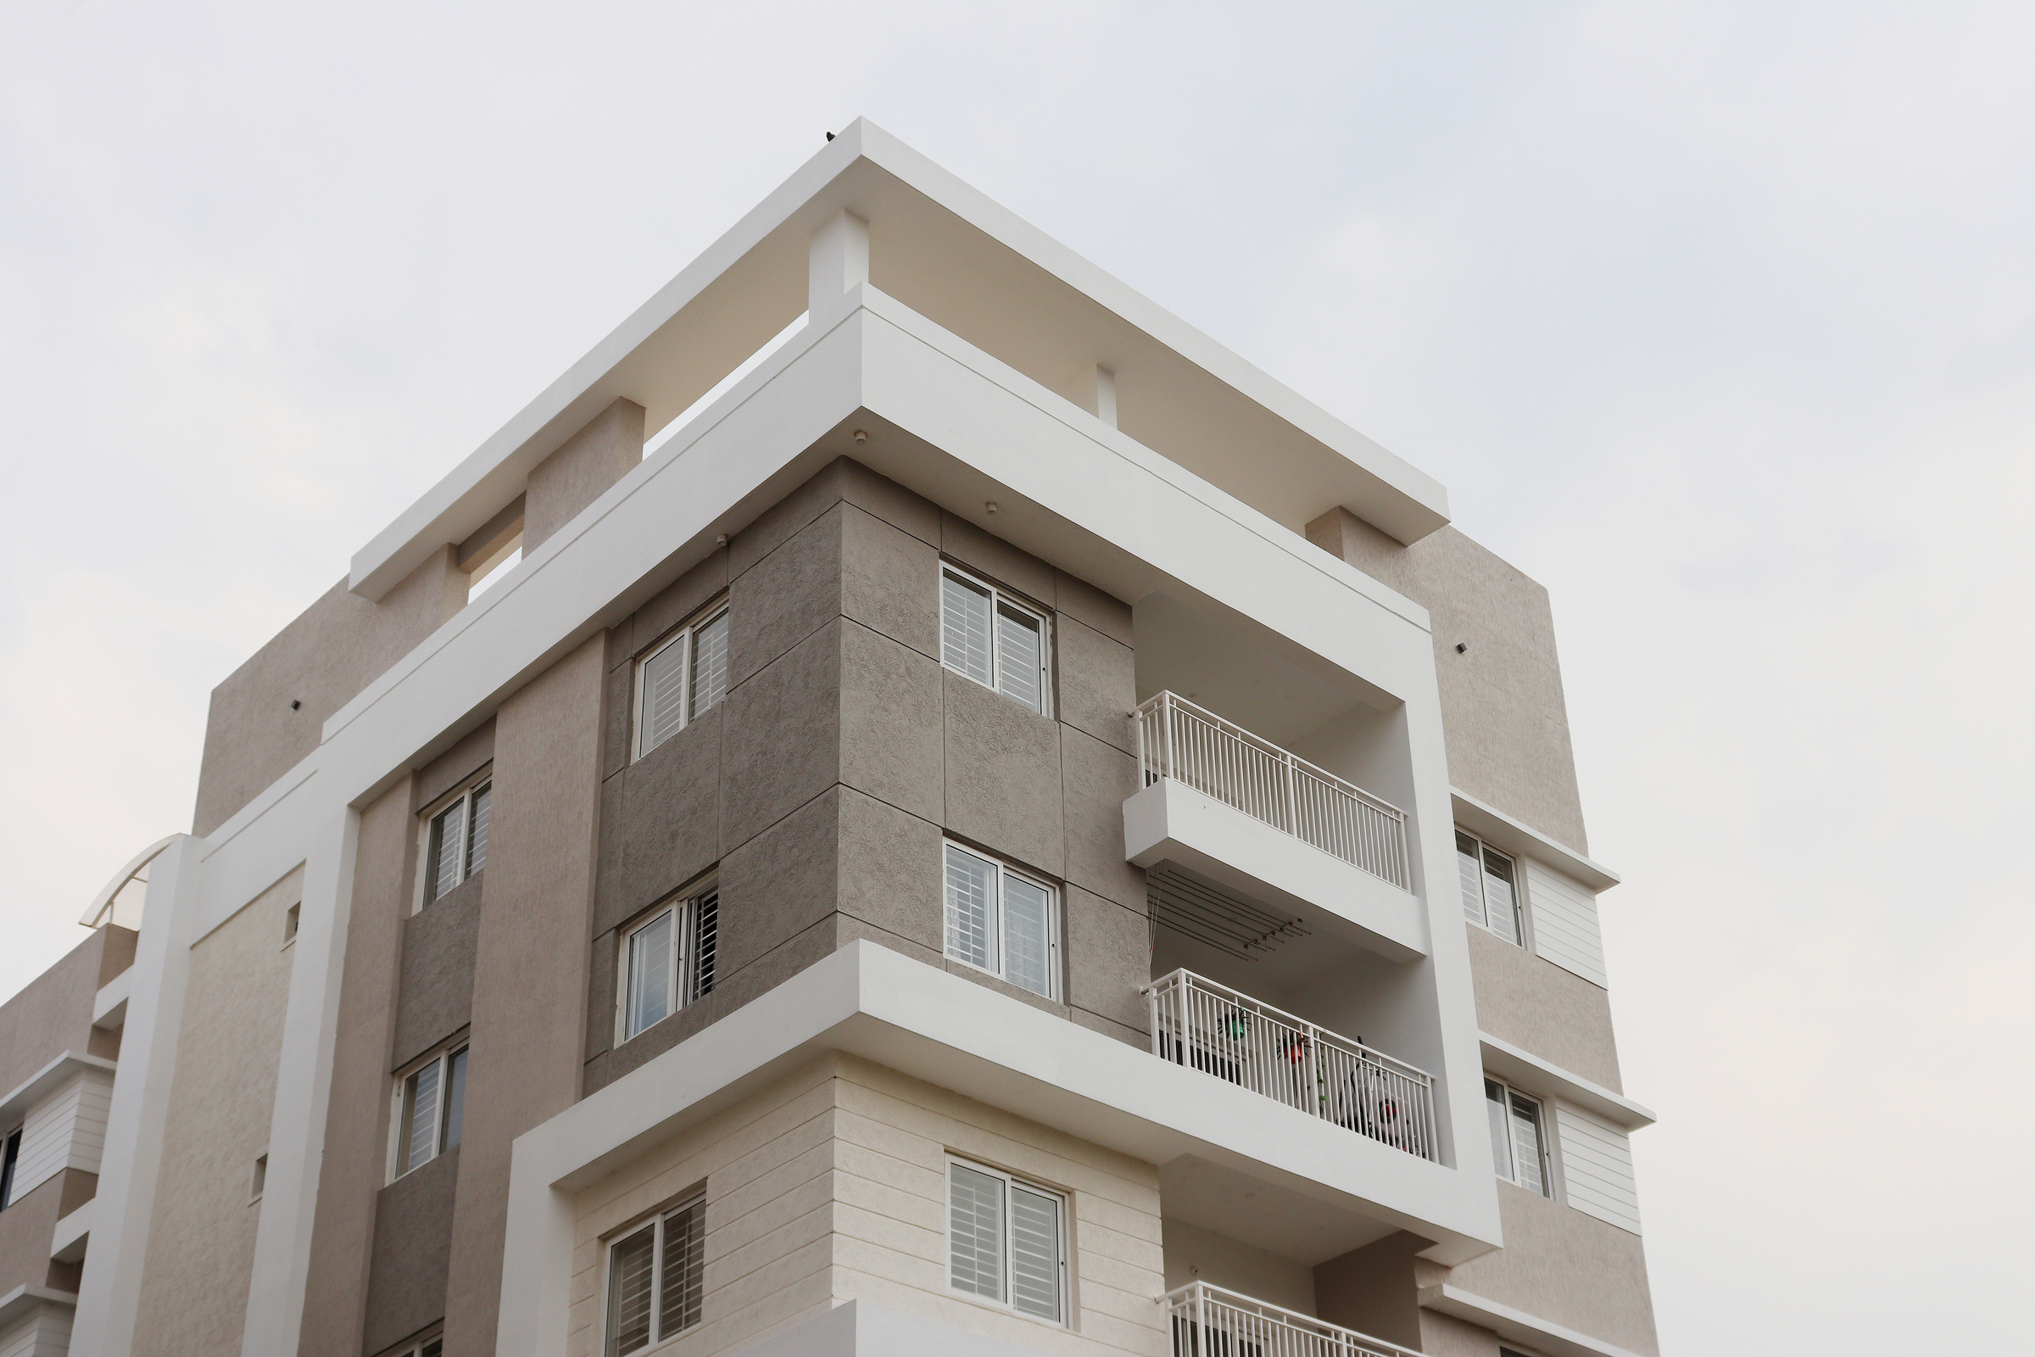
BaudRate9600
8 MARCH 2025
VISION & MISSION
To transform urban landscapes into interconnected, resilient communities where technology empowers citizens and enhances the quality of life.
Mission
Smart City Sentinel is dedicated to integrating IoT, AI, and data analytics into a unified platform that provides:
Real-time insights for better decision-making
Predictive analytics to anticipate and address urban challenges
Rapid emergency response to enhance public safety
Enhanced security, efficiency, and transparency in city operations
Sustainable growth strategies for smarter and greener cities
Data-driven governance to empower city leadership
By leveraging these innovations, we aim to create safer, smarter, and more efficient urban environments for everyone.

Slide 5

BaudRate9600
8 MARCH 2025
OUR APPROACH
We deploy a robust network of hardware sensors—ranging from environmental and flame sensors to ESP32 microcontrollers and cameras—for comprehensive data collection at the edge. These devices feed real-time data into our software stack, which leverages Python-based data processing, machine learning frameworks (e.g., TensorFlow/PyTorch), and cloud-native technologies for scalable analytics. By integrating microservices, REST APIs, and container orchestration tools, our platform ensures seamless communication between hardware endpoints and centralized data processing layers. This holistic, tech-forward methodology allows for proactive decision-making, streamlined operations, and enhanced safety in urban or industrial environments.

Slide 6
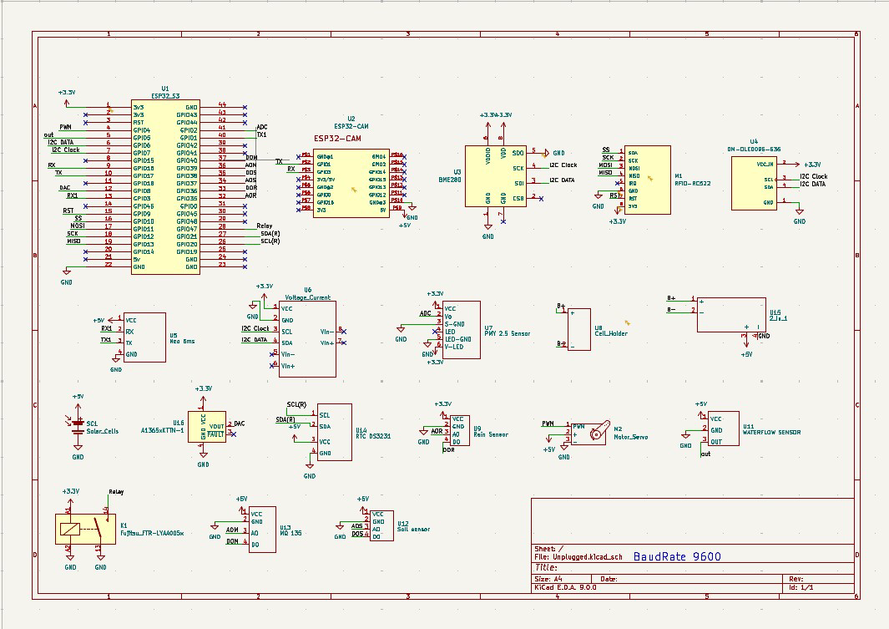
BaudRate9600
8 MARCH 2025
Schematics

Slide 7
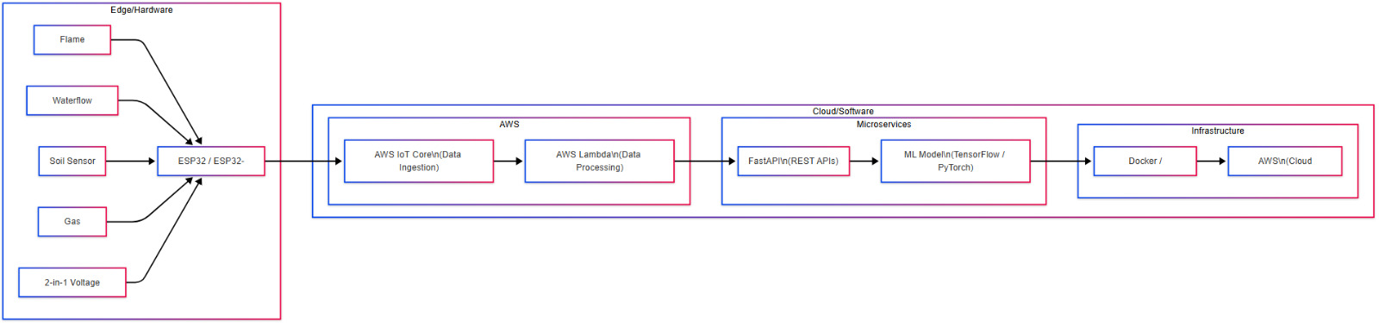
BaudRate9600
8 MARCH 2025
TECH STACK

Slide 8

BaudRate9600
8 MARCH 2025
FUTURE PROSPECTS
The Smart City Sentinel will evolve with AI-driven traffic predictions to prevent congestion before it happens. It will integrate with autonomous vehicles for seamless traffic coordination. Enhanced smart surveillance will improve security with crime detection and facial recognition. The system will also manage pedestrian and public transport flowfor better city planning. With IoT-connected infrastructure, traffic signals, sensors, and emergency services will work together in real-time. As it scales globally, it will contribute to smarter, more efficient cities. Ultimately, this technology will support sustainability by reducing emissions and improving urban mobility.

Slide 9

CONCLUSION
This project demonstrates a cutting-edge integration of hardware and software technologies to revolutionize urban monitoring and management. By leveraging a diverse sensor array, ESP32 microcontrollers, and a robust AWS-based data processing pipeline—including IoT Core, Lambda, and containerized microservices—the system delivers real-time analytics and predictive insights essential for proactive decision-making. As cities continue to grow and evolve, the prospects of enhanced edge computing, AI-driven security, and expanded IoT connectivity promise to further transform urban landscapes into smarter, more resilient environments.

